Slide 1



Spotify Analysis
View in Power BI
Last data refresh:
05/05/2025 23:57:56 UTC
Downloaded at:
05/05/2025 23:59:22 UTC

Slide 2
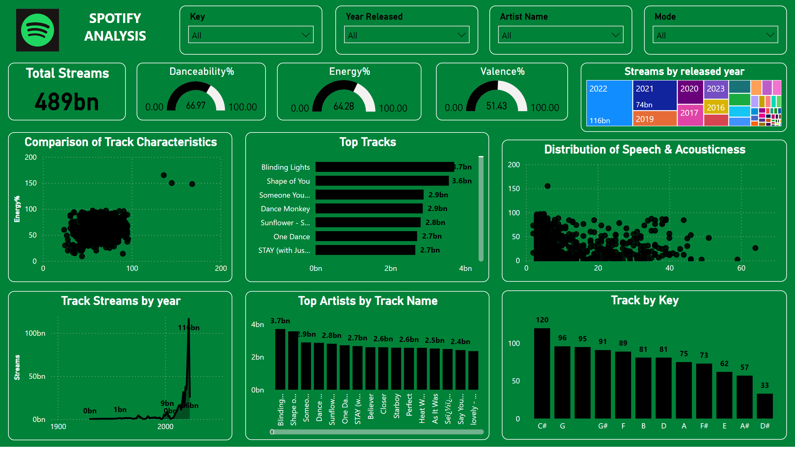
Page 1
Notes:
slicer
No alt text provided
slicer
No alt text provided
slicer
No alt text provided
slicer
No alt text provided
Total Streams
No alt text provided
Danceability%
No alt text provided
Energy%
No alt text provided
Valence%
No alt text provided
Streams by released year
No alt text provided
Comparison of Track Characteristics
No alt text provided
Top Tracks
No alt text provided
Distribution of Speech & Acousticness
No alt text provided
Track Streams by year
No alt text provided
Top Artists by Track Name
No alt text provided
Track by Key
No alt text provided
image
No alt text provided
textbox
No alt text provided

